Slide 1

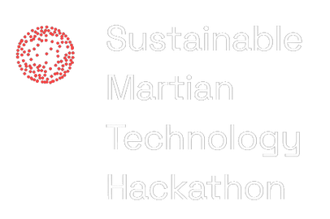

Project MARS
Pitch Deck
TEAM NAME
WARDIERE, INC.

Slide 2
Problem Statement
Example: Soil often consists of a variety of components, in some cases, chemicals that can be dangerous agriculture, specifically crops growing food to be consumed by animals and humans.

Slide 3
Solution Overview
Example: Project MARS offers an AI-powered solution to identify chemical soil components that are used in crowing crops.

Slide 4
Overview of Solution
Explain what makes your solution unique and explains the technical mechnisms that provide value to your solution.

Slide 5
Market Opportunity
Example: Project MARS is a solution that can benefit farmer in x,y, and z.
Project MARS will benefit commerical space exploration and settlement when processing moon/Martian soil in preparation for agricultural activities.

Slide 6
Business
Model
Revenue through a XYZ model with montly software subscription.
Commercial space companies?
Academic Institutions?

Slide 7
Market Strategy
Example: Focus on marketing in the health and food industry, research initiaves academic institutions, and collaborations with XYZ.

Slide 8
Competitive Analysis
Comparison with competitors like Stylebook and Cladwell, highlighting unique strengths such as AI-powered suggestions and a strong focus on sustainability.

Slide 9
Projections
Over the next year, we anticipate a ....
Over the next five years, we anticipate a ....

Slide 10
Contact Information
hello@XYZ.com - www.XYZ.com
WARDIERE, INC.

